Slide 1
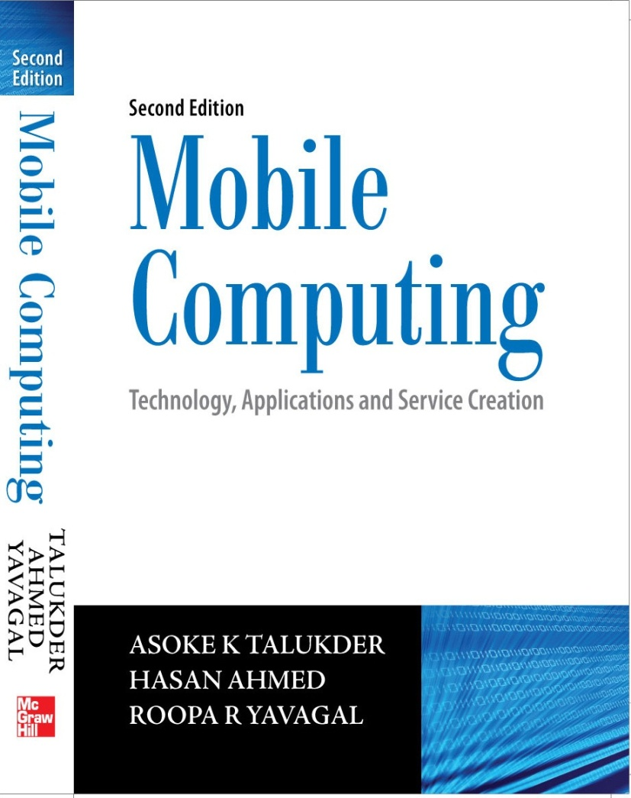
Mobile Computing
Notes#2
Mobile Computing Architecture
© Tata McGraw Hill

Slide 2
History of Computers - I
German engineer Konrad Zuse developed a computer called Z3 to design airplanes and missiles in 1941 during World War II.
In 1943, the British developed a computer called Colossus for cryptanalysis to decode encrypted messages transacted by Germans.
In 1944, Howard H. Aiken developed the Harvard – IBM Automatic Sequence Controlled Calculator Mark I, or Mark I for short.
Electronic Numerical Integrator and Calculator, better known as ENIAC, was developed by John P. Eckert and John W. Mauchly in 1946.
In 1945, John von Neumann introduced the concept of stored program.

Slide 3
History of Computers - II
In 1947, the invention of the transistor by J. Bardeen, Walter H. Brattain, and William Shockley at Bell Labs changed the development scenario of digital computers. The transistor replaced the large, energy hungry vacuum tubes in first generation computers.
Jack Kilby, an engineer with Texas Instruments, developed the Integrated Circuit (IC) in 1958.
By the 1980's, Very Large Scale Integration (VLSI) squeezed hundreds of thousands of components onto a chip that led the development of third generation computers.
All these early computers contained all the components we find today in any modern day computers: like printers, persistent storage, memory, operating systems, and stored programs. However, one aspect of modern day computers was missing in these machines – the networking aspect of today’s computers.

Slide 4
History of Internet – I
Following the successful launch of Sputnik in 1957 by the Russians, USA felt the need of research in certain focused areas. Therefore, Advance Research Project Agency (ARPA) was formed to fund Science and Technology projects and position USA as a leader in technology.
In early sixties, Leonard Kleinrock developed the basic principles of packet switching at MIT.
During the same period, Paul Baran in a series of RAND Corporation reports recommended several ways to accomplish packet switch network.
In 1965, working with Thomas Merrill, Lawrence G. Roberts connected the TX – 2 computer in Massachusetts to the Q-32 in California with a low speed dial – up telephone line creating the first computer network.

Slide 5
History of Internet – II
In 1971, Ray Tomlinson at BBN wrote the software to send and read simple electronic mail.
In October 1972, demonstration of the ARPANET was done at the International Computer Communication Conference (ICCC). This was the first public demonstration of this new network technology to the public. It was also in 1972 that the initial "hot" application – electronic mail, was introduced.
In 1986, the US NSF initiated the development of the NSFNET which provided a major backbone communication service for the Internet.
In Europe, major international backbones such as NORDUNET and others provided connectivity to a large number of networks. Internet slowly evolved as the universal network of networks, which connects almost every data networks of the world with a reach spread over the whole of earth.

Slide 6
History of Internet – III
On October 24th, 1995, the FNC unanimously passed a resolution to officially define the term Internet. According to this resolution, the definition of Internet is “Internet refers to the global information system that – (i) is logically linked together by a globally unique address space based on the Internet Protocol (IP) or its subsequent extensions / follow – ons; (ii) is able to support communications using the Transmission Control Protocol / Internet Protocol (TCP/IP) suite or its subsequent extensions / follow – ons, and / or other IP –compatible protocols; and (iii) provides, uses or makes accessible, either publicly or privately, high level services layered on the communications and related infrastructure described herein.”
V. Bush through his July 1945 essay “As We May Think”, described a theoretical machine called a "memex”, which was to enhance human memory by allowing the user to store and retrieve documents linked by associations.

Slide 7
History of Internet – IV
During 1960s, D. Engelbart prototyped an "oNLine System" (NLS) that does hypertext browsing, editing, etc. He invents the mouse for this purpose.
In 1991, Tim B. Lee invented Hyper Text Markup Language (HTML) and Hyper Text Transport Protocol (HTTP). Tim wrote a client program and named it as “World Wide Web”, which finally became the “www” (World Wide Web) and became almost synonymous with Internet.

Slide 8
Internet – The Ubiquitous Network
Two ubiquitous networks – the telecommunications network and the Internet
Glue for telecommunications network – SS#7 (loosely)
Glue for the Internet – TCP/IP
Three basic types of content – audio, video and text
Three main segments of any network – Core, Edge and Access
Core – backbone of network and looks at the traffic from the stream of bits point of view
Edge – responsible for the distribution of traffic and looks at the traffic from the service point of view
Access – deals with last mile of transmission

Slide 9
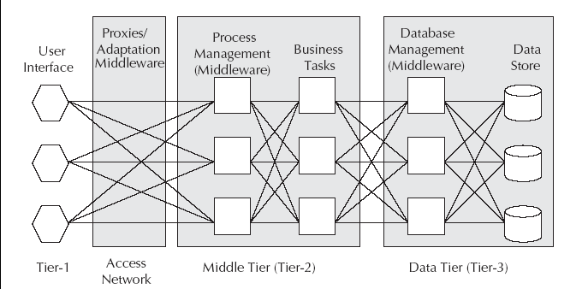
Architecture of Mobile Computing
The three tier architecture contains the user interface or the presentation tier, the process management or the application tier and the data management tier.

Slide 10
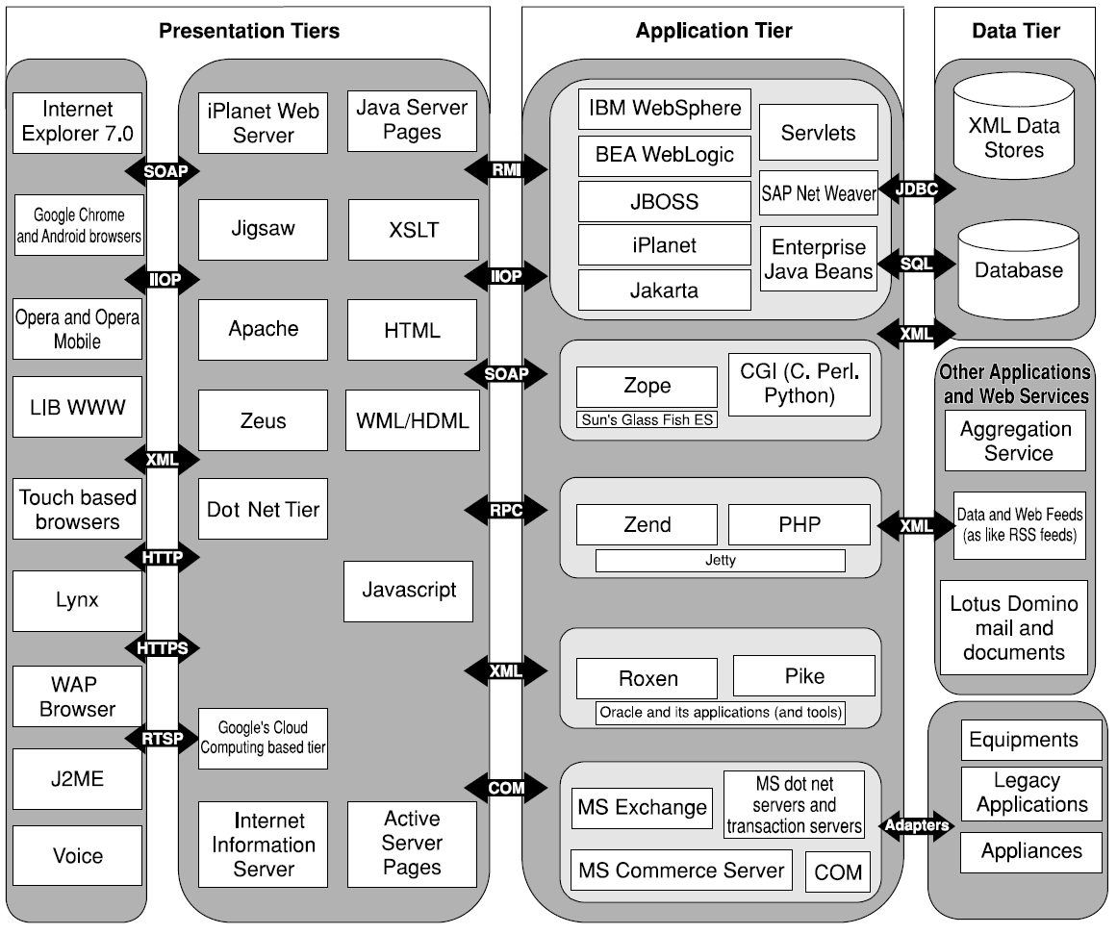
Mobile Computing Architecture

Slide 11
Presentation Tier
Responsible for presenting the information to the end user
Run on the client device and offer all the user interfaces
Includes web browsers, WAP browsers and client programs

Slide 12
Application Tier
Independent of presentation and database management
Handles functions related to middleware
Middleware – layer of software sitting between the operating system and user facing software
Many types of middleware – Message Oriented Middleware, Transaction Processing Middleware, Communication Middleware, Distributed Objects and Components, Transcoding Middleware, Web Services, etc.

Slide 13
Message Oriented Middleware
Loosely connects different applications through asynchronous exchange of messages
Works independent of platform or processor configuration
Generally asynchronous and peer to peer
Works in publish / subscribe fashion
Examples – MQ series from IBM, JMS, etc.

Slide 14
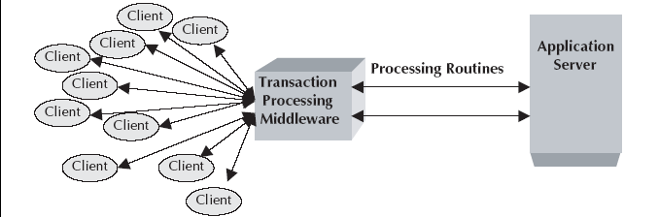
Transaction Processing Middleware
Provides tools and environment for developing transaction based distributed applications
Capable of providing services to thousands of clients in a distributed client – server environment
Independent of database architecture
Example – CICS from IBM

Slide 15
Communication Middleware
Used to connect one application to another
Quite useful in the telecommunications world
Uses mediation server to automate the telnet protocol to communicate to nodes in the network
Example – Using telnet to connect one application to another

Slide 16
Distributed Objects and Components
Handles open distributed object computing infrastructure
Example – Common Object Request Broker Architecture (CORBA)
CORBA – a vendor independent infrastructure
CORBA – highly interoperable across heterogeneous platforms

Slide 17
Transcoding Middleware
Used to transcode one format of data to another suiting the needs of the client
Useful for content adaptation to fit the needs of device
Example – Internet Content Adaptation Protocol (ICAP) from IETF

Slide 18
ICAP
Aimed at providing simple object based content vectoring for HTTP services
Lightweight protocol to do transcoding on HTTP messages
Similar to executing a RPC on a HTTP request
Adapted messages can either be HTTP requests or HTTP responses

Slide 19
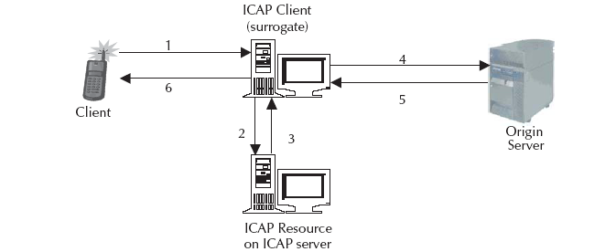
Data flow in an ICAP environment
1. A user agent makes a request to an ICAP-capable surrogate (ICAP client) for an object on an origin server.
2. The surrogate sends the request to the ICAP server.
3. The ICAP server executes the ICAP resource’s service on the request and sends the possibly modified request, or a response to the request back to the ICAP client.
Continued…

Slide 20
4. The surrogate sends the request, possibly different from the original client request, to the origin server.
5. The origin server responds to the request.
6. The surrogate sends the reply (from either the ICAP server or the origin server) to the client.

Slide 21
Web Services
Provides a standard means of communication and information exchange among different software applications
Public interfaces and bindings are defined using XML
Standards for service requestor and service provider
Service requestor – find and discover the description of services
Service provider – publish the description of services it provides

Slide 22
Data Tier
Used to store data needed by the application and acts as a repository for both temporary and permanent data
Can use XML for interoperability of data with other systems and data sources
Might incorporate the use of Database Middleware and SyncML
Database Middleware – interfaces application programs and the database
Database Middleware – helps business logic run independent and transparent from database technology and database vendor

Slide 23
SyncML
Emerging standard for synchronization of data access from different nodes
Promotes a single common data synchronization protocol that can be used industry wide
Supports naming and identification of records and common protocol commands to synchronize local and network data
Works over all networks used by mobile devices – wired and wireless

Slide 24
Design Considerations
Context information is the information related to the surrounding environment of an actor in that environment.
Mobility implies that attributes associated with devices and users will change constantly.
Such changes shall mean that content and behavior of applications should be adapted to suit the current situation.
Some examples are:
Content with context awareness
Content switch on context
Content transcoding on context

Slide 25
Concerning contexts in Mobile Computing
The following contexts need to be taken care of:
User context
Device context
Network context
Bandwidth context
Location context
Time context
Environment context
Charging context
Security context

Slide 26
Handling user context
Who is the user?
In Trusted Personal Devices (TPD), and certain desktop environments user can be assumed from a particular environment.
For example, anybody from USIU can access the digital library.
In general, desktops are shared devices and user context is dynamic.

Slide 27
Handling device context
What is the device behavior?
What is the display size?
Does it support color?
Does it support SyncML?
What bearers it supports?
Is there any shared object between applications in device
and server?
Can we identify the device without ambiguity (like IMEI)?

Slide 28
Handling network context
What is the security policy in the network?
What are the available bearers in the network?
What are the different nodes in the network?
Does the network offer positioning information?
What are the different services available within the network?
What are the services the user has subscribed to?

Slide 29
Handling bandwidth context
What is the bandwidth available for this network?
What is the bandwidth the subscriber is allowed to?
Is there any service level agreement on bandwidth between the user and network?
Who pays for the bandwidth?

Slide 30
Handling location context
Can we locate the device?
What is the positioning information (For example, is the car facing north way or south way in the highway)?

Slide 31
Handling time context
Can we identify the timezone of the client?
Can we get the timestamp of the client?
Can we synchronize the clock?
Providing information based on time. For example, I finish my meeting at 4:00 PM, the system can tell me that I can visit a museum and the close by aquarium followed by dinner in a Chinese restaurant.

Slide 32
Handling environment context
What are the environmental conditions of the surrounding?
Essential for sensor based networks
Essential for telematic applications
Essential for embedded systems

Slide 33
Handling charging/billing context
Who pays for this service?
How to collect the usage information?
Whom to send the information for billing the end user?
What are the principles of sharing the revenue with other service providers?

Slide 34
Handling security context
What is the security context?
Can we authenticate the device?
Can we authenticate the user of the device?
Is the network trusted? If not, what is required to build the trust?
Is the network encrypted?
What types of encryption does the client support?
Does the client have a WIM (Wireless Identification Module)?
Does the client have a private key?

Slide 35
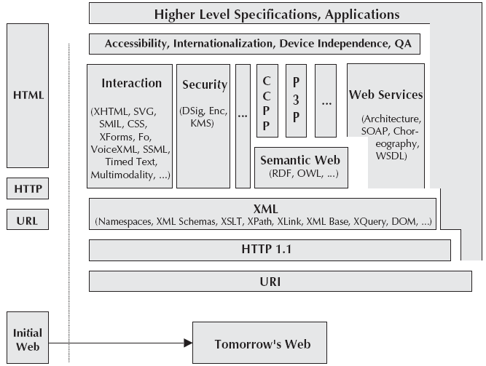
Content architecture in Mobile Computing

Slide 36
Client Context Manager (CCM)
Maintains information pertaining to:
Mobile devices
Users
Location
Network
Environment around each mobile device

Slide 37
Challenges with CCM
Context definition: Defining context attributes with interoperability in mind; how will every GPS device know the current data format?
Context sensing: The way context data is obtained; e.g. GPS data acquisition
Context representation: The way context information is stored and transported; e.g. transmitting such information
Context interpretation: The way the context data is interpreted; e.g. we might need additional GIS information to interpret the GPS data

Slide 38
Contexts handled by CCM
Identity
Spatial and temporal information
Environmental information
Social information
Proximity and availability of resources
Physiological measurements
Activity
Schedules and agendas

Slide 39
Functions of the CCM
Responsible for receiving raw context data, collating the data into a useful form and disseminating it to context consumers.
Present context information to consumers in suitable and interoperable form.
Context model should allow aggregation.
Dynamic updates should be possible.
Context history should be available.
Context should be filtered.

Slide 40
Composite Capabilities/Preference Profiles
Proposed W3C standard for describing device capabilities and user preferences
Based on Resource Description framework (RDF)
Can be serialized using XML
Origin server or proxy can perform some sort of content to device matching
Abbreviated as CC/PP

Slide 41
CC/PP in action
Device sends serialized profile model with request for content.
Origin server receives serialized RDF profile and converts it into an in – memory model.
The profile for the requested document is retrieved and an in –memory model is created.
The device profile model is matched against the document profile model.
A suitable representation of the document is chosen. Either content switch on context or content transcoding on context is employed.
Document is returned to device and presented.

Slide 42
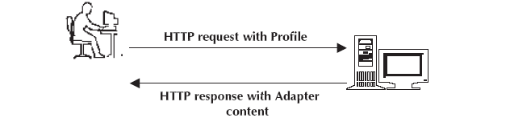
Simplest use of CC/PP

Slide 43
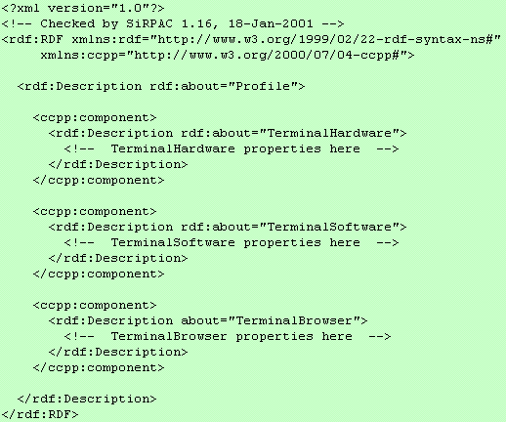
Format for RDF

Slide 44
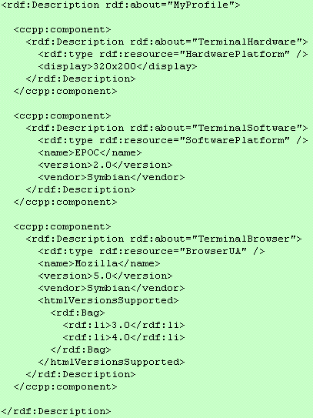
Example for RDF

Slide 45
Parser for RDF
Java based RDF parser (SiRPAC) is available free on the web.
SiRPAC can be used to parse serialised RDF into triples.
Triples are the output of RDF parsers and are of the form triple (subject, predicate, object).
Using triples, it is possible to build a CC/PP model. The model is updated whenever new context data are sent from context sources.

Slide 46
Policy Manager
Responsible for controlling policies related to mobility
Should be able to define policy for documents/services and assign roles to user
Should assign roles to users like
Permission
Prohibition
Obligations
Policy combined with context should determine
what action(s) the user is allowed to perform?
what action(s) the user is obliged to perform?
the policy applicable

Slide 47
Semantic Web
Facilitates putting machine understandable data on the web
Facilitates web definition and linking in a way to be useful for machines in the context of automation, security, filtering, integration and data reuse
Increases the modularity of web applications
Built on syntaxes which use URI’s to represent data
Such syntaxes are called Resource Description Framework (RDF) syntaxes

Slide 48
Security Manager
Secures connection between client device and origin server
Should handle
Confidentiality (managed by encryption)
Integrity (managed by algorithms)
Availability (relates to peripheral security)
Non – repudiation (managed by digital signatures)

Slide 49
Platform for Privacy Preference Project
Emerging standard defined by W3C
Enables websites to express their privacy practices in a standardized format retrievable and interpretable by user agents
Any discrepancies between a site’s practices and the user preferences can be flagged as well
Does not provide any mechanism for ensuring that websites act according to their policies
Intended to be complementary to both legislative and self–regulatory programmes

Slide 50
Adaptability Manager
Based on context and policy , it should adapt to:
Content
Behaviour
Other aspects
May take any number of actions depending upon the information passed to it by Context Manager
May include appending location – specific information to documents

Slide 51
Content adaptation
Content should be able to adapt to dynamic situations.
Adaptation can be static or dynamic.
Content adaptation can be performed either at content level in server or agent level in client.
Content adaptation can be handled by middleware as well.
Content adaptation needs to consider the physical and logical capabilities of the device, effective network bandwidth and payload (total number of bits delivered to the agent for static parts).

Slide 52
Content transcoding
The resource requirements for the client devices can be determined by:
Static content size in bits
Display size
Streaming bit rate
Colour requirements
Compression formats
Hardware requirements

Slide 53
Types of content transcoding
Spatial transcoding
Temporal transcoding
Colour transcoding
Code transcoding
Object or semantic transcoding

Slide 54
Content rating and filtering
Need to ensure social discipline in the electronic world
Platform for Internet Content Selection (PICS)
PICS – W3C proposed standard for web content rating
PICS – set of technical specifications for labels that help software and rating services to work synergistically
PICS – services should choose their own criteria for proper identification and filtering of content
Rating can be through self labeling or third party labeling
Originally designed to help parents and teachers control children access to the Internet
Also includes code signing and privacy

Slide 55
RSACI
Acronym for Recreational Software Advisory Council – Internet
Has a PICS compliant rating system called Resaca
Resaca has four categories – violence, nudity, sex and language
Has a rating range from 0 to 4
0 means no potentially offensive content
4 means highest level of offensive content
PICS – a general meta data system
PICS labels – helpful in finding desirable content on the web
PICS – enables more sophisticated commerce, communication, indexing and searching services

Slide 56
Content Aggregation
From the content aggregator’s perspective, services are of two categories:
Single service request – works at user level and for one user
Example : A user may request a webpage in Chinese from proxy server. Here, the user buys both the content and translation service.
Group service request – works for a group of users
Example : The content aggregator has some arrangement for advertisement. It examines all HTML pages and inserts an advertisement at an appropriate place.

Slide 57
Seamless Communication
A ubiquitous system involves availability and accessibility from anywhere, anytime and through any network or device.
Seamless communication shall involve seamless handovers and seamless roaming.
Handoff is the process by which the connection to the network is moved from one base station to another within the same network without discontinuing the service.
Roaming shall involve the point of attachment moving from one base station of one network to a base station of another network.

Slide 58
Aspects of Seamless Communication
Authentication across network boundaries
Authorization across network boundaries
Billing and charging data collection
End – to – end data security across roaming
Handoff between wireless access points
Roaming between networks
Session migration
IP mobility

Slide 59
Autonomous Computing
The purpose of autonomous computing is to free users and system administrators from the details of the system operation and maintenance complexity. It combines the following functions:
Self configurable
Self optimizing
Self healing
Self protecting
Self upgradable

Slide 60
Context aware systems
The following information needs to be handled in a mobile computing environment for making a system context aware:
Location information
Device information
Network information
User information
Environment information

Slide 61
Global Positioning System
Gives the exact positioning on Earth
Funded and controlled by US Department of Defense
Has three parts – the space segment, the user segment and control segment.
Has 24 satellites , each in its own orbit 11,000 nautical miles above Earth.

Slide 62
Making existing applications mobile enabled
Enhancing an existing application
Renting an application
Developing a new application
Buying a packaged solution
Bridging the gap through middleware

Slide 63
Next Topic
Mobile Computing through Telephony

